Slide 2
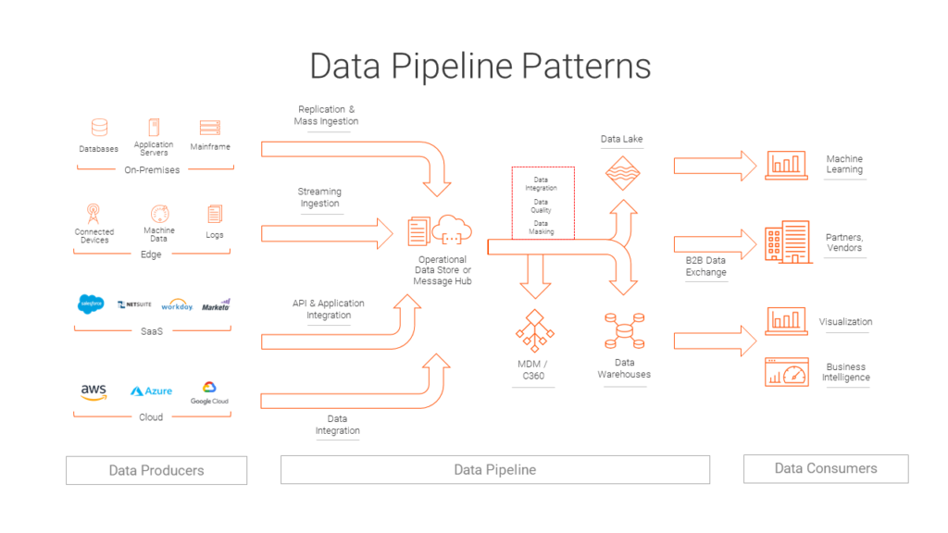
https://blogs.informatica.com/2019/08/20/data-processing-pipeline-patterns/

Slide 3
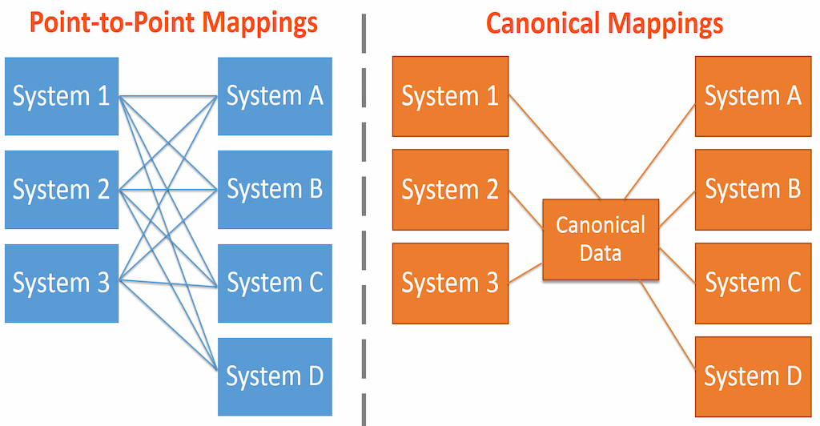
https://www.bmc.com/blogs/canonical-data-model/

